Slide 1
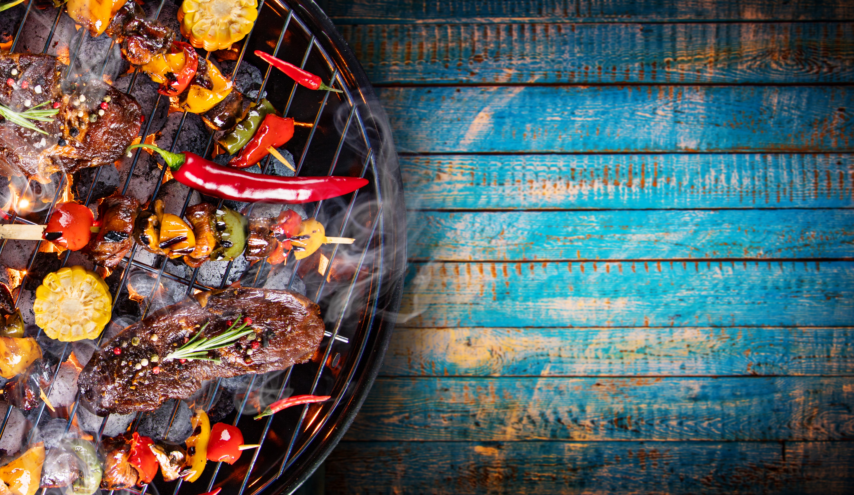
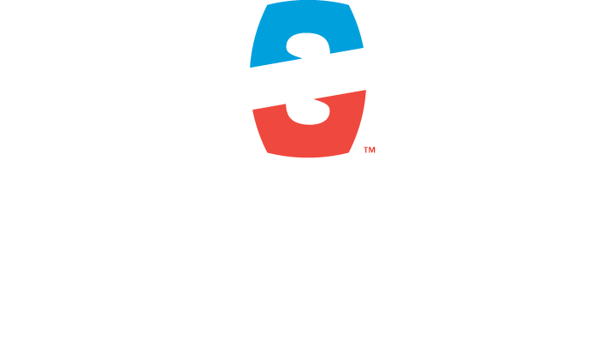

Slide 2

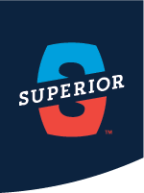
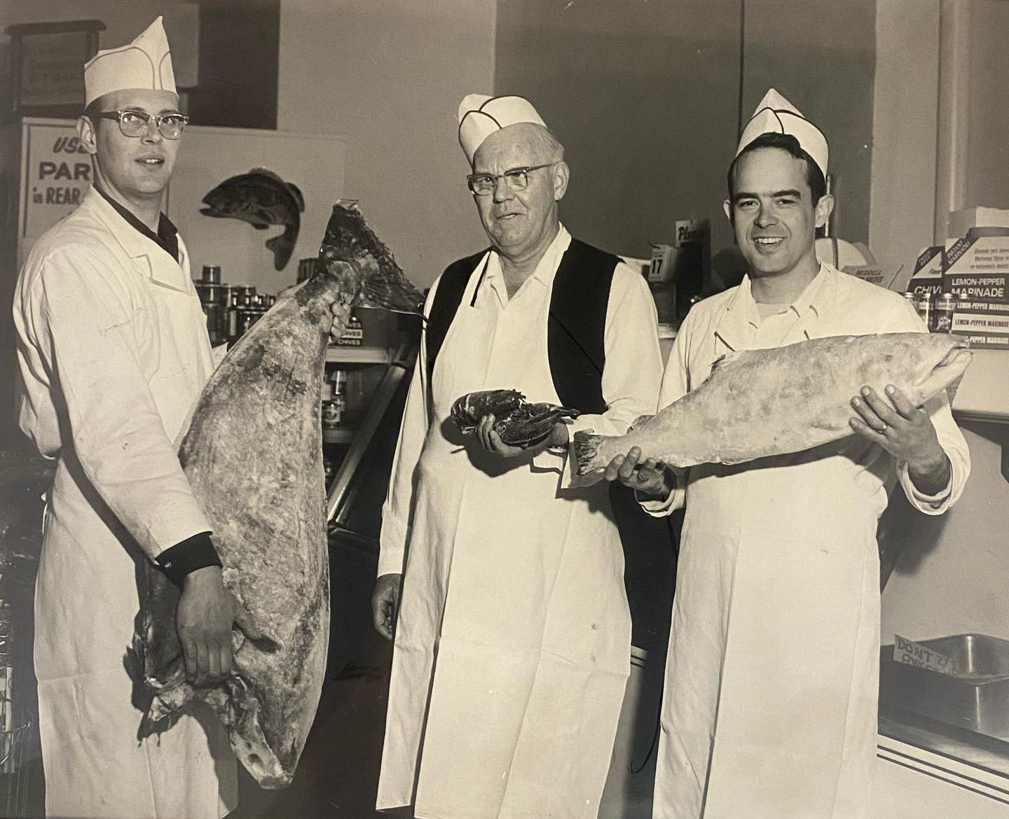
OVER SEVEN DECADES
IN THE MAKING
Four generations ago, in the mid 1950’s, a dream turned into reality. In an old, converted butcher shop in the Heartside neighborhood of downtown Grand Rapids, MI…Superior Fisheries was born. Unique in its offering of fish and seafood in a very ‘meat and potatoes’ part of the country, it quickly found its niche in selling fish and chips - freshly fried, piping hot and ready to eat. It didn’t take too many years to outgrow its next two locations…and its name, as well. To keep pace, 10 acres of land was purchased ‘out in the country’, south of town and Superior Seafoods Co. would move into its brand-new facility in April of 1978.

Slide 3
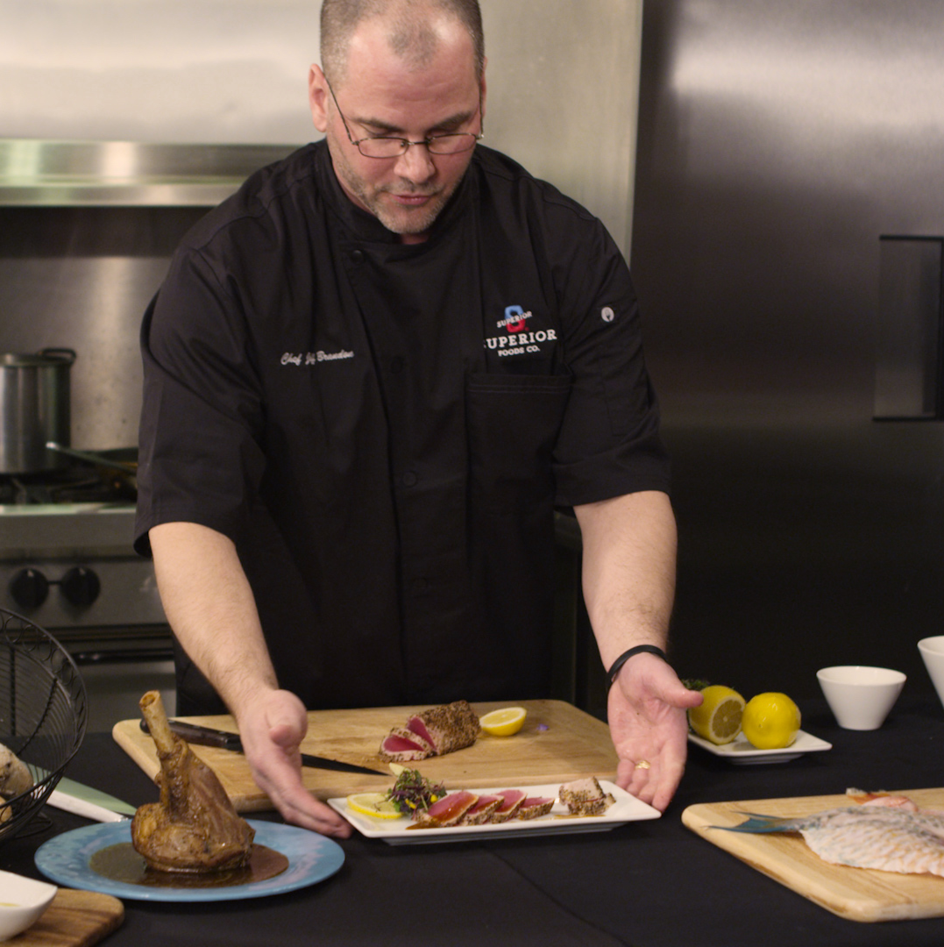
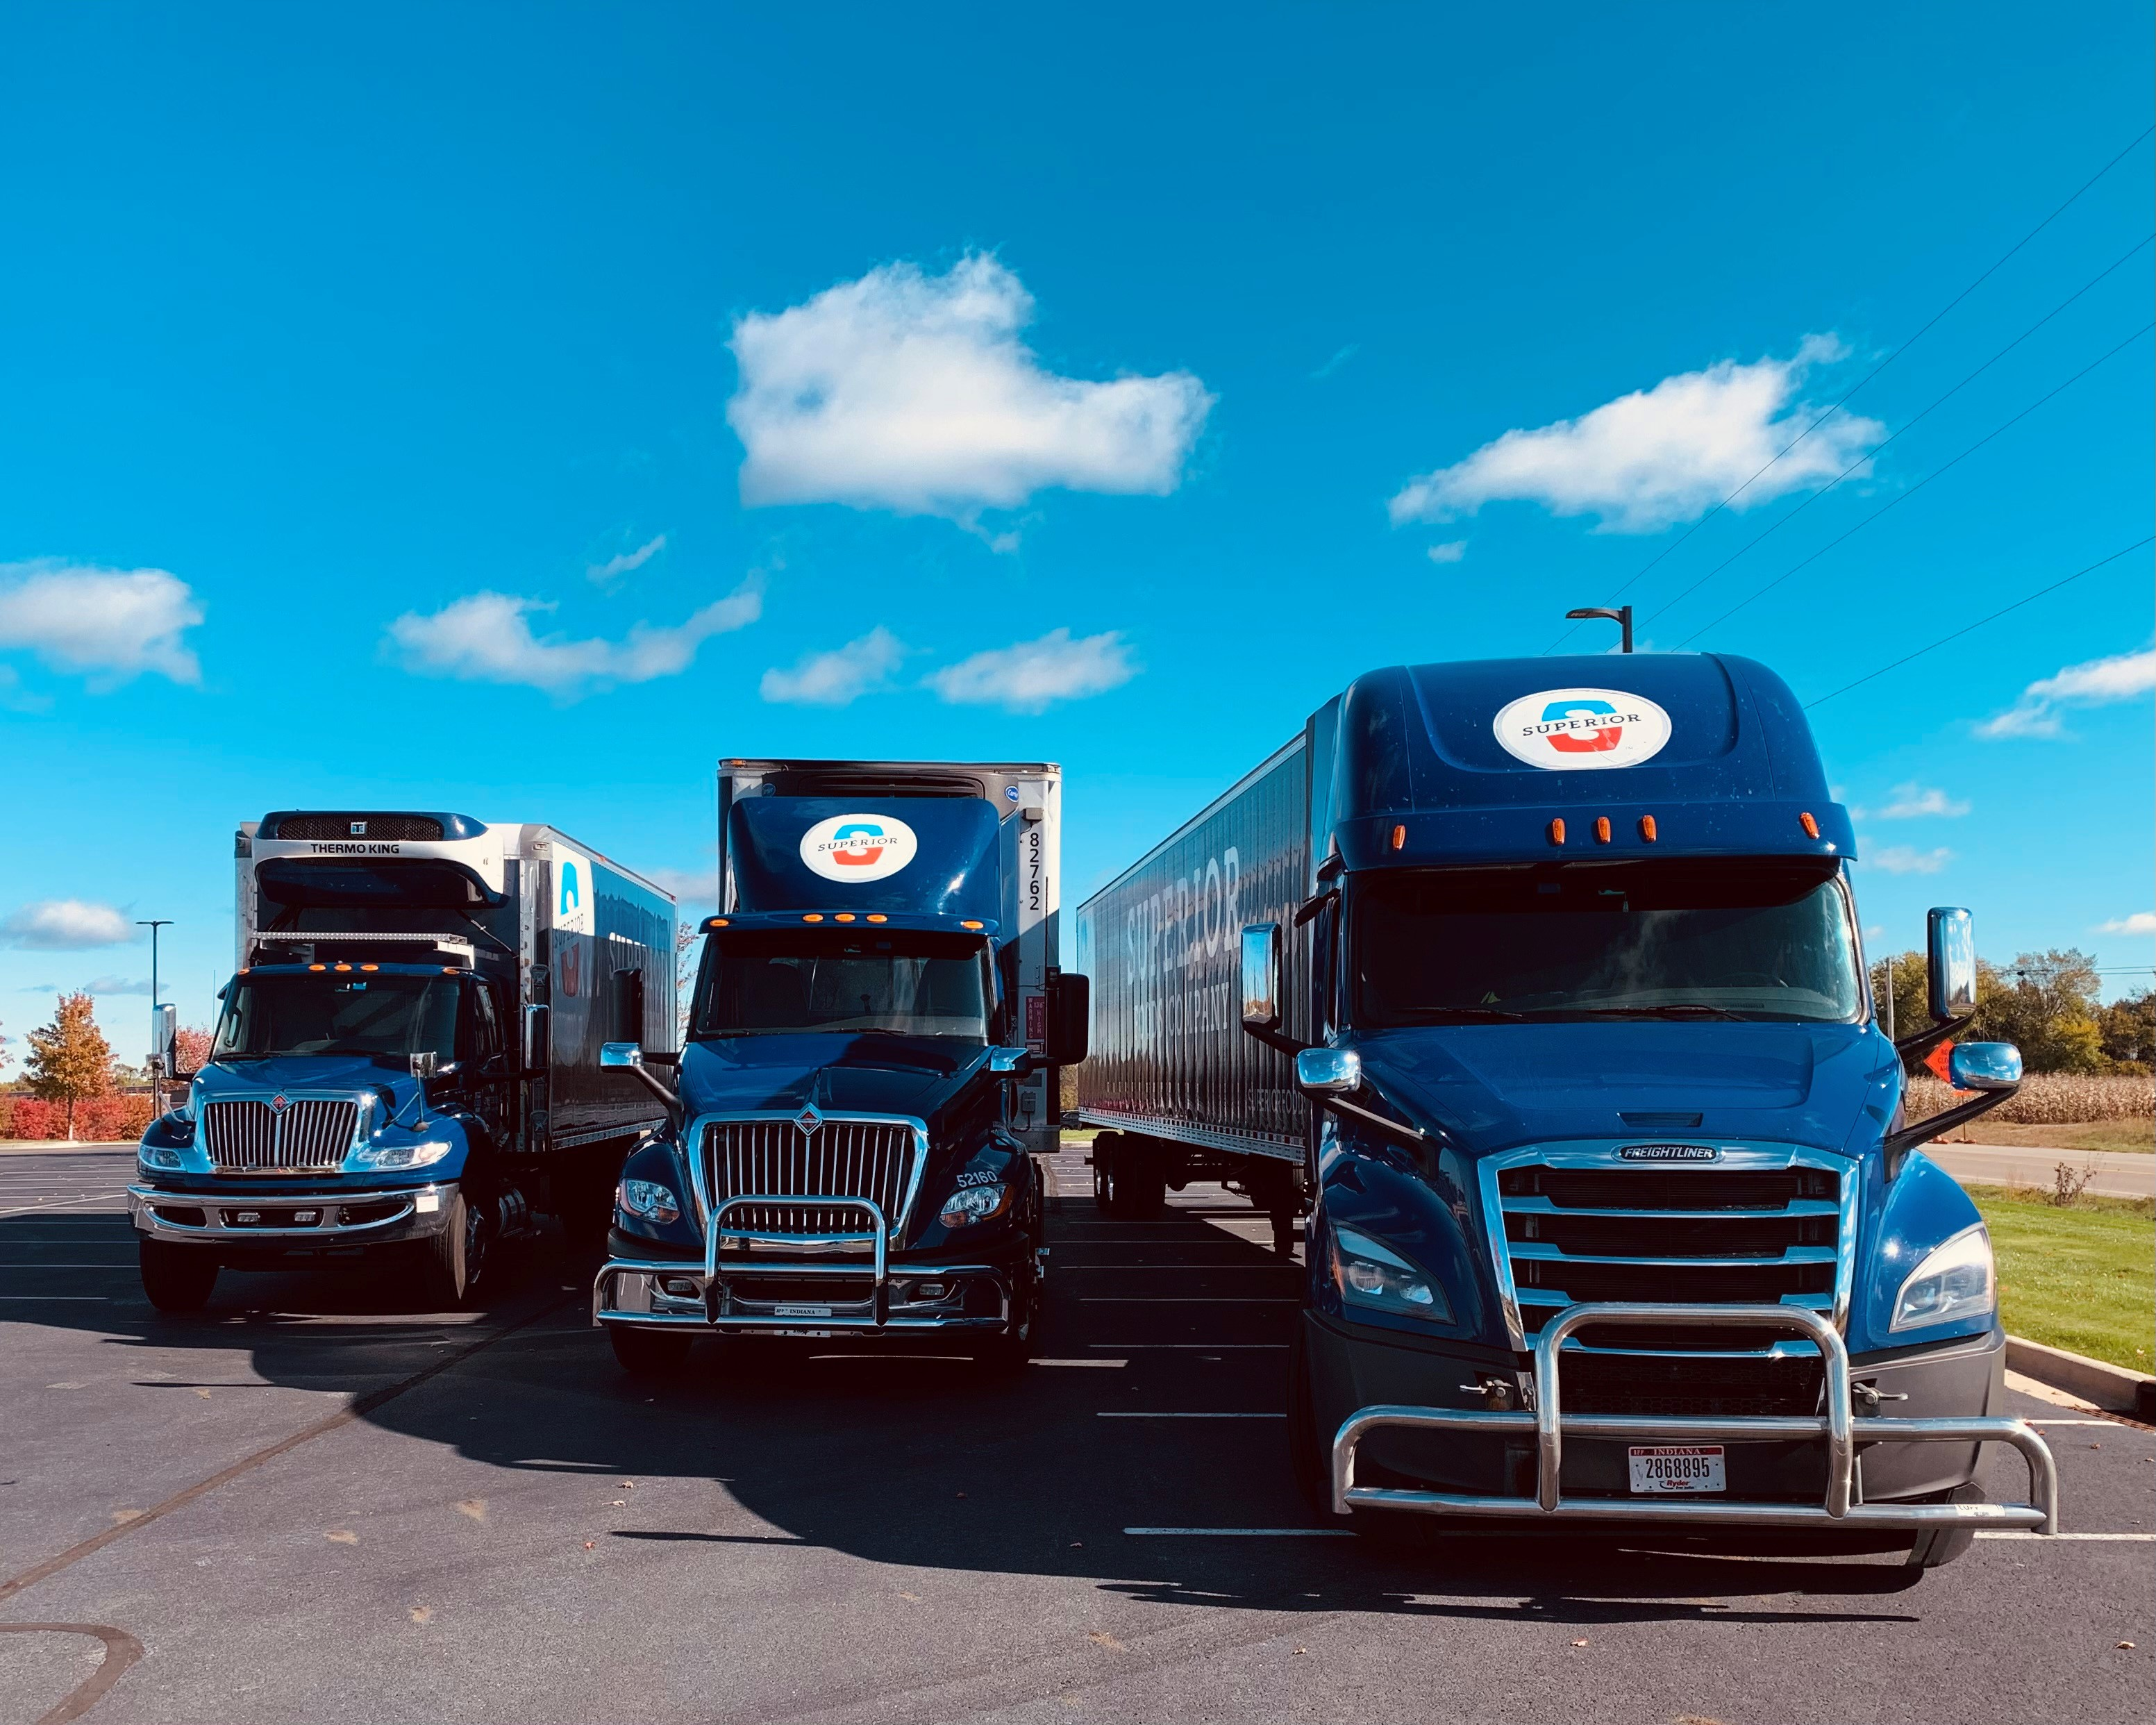
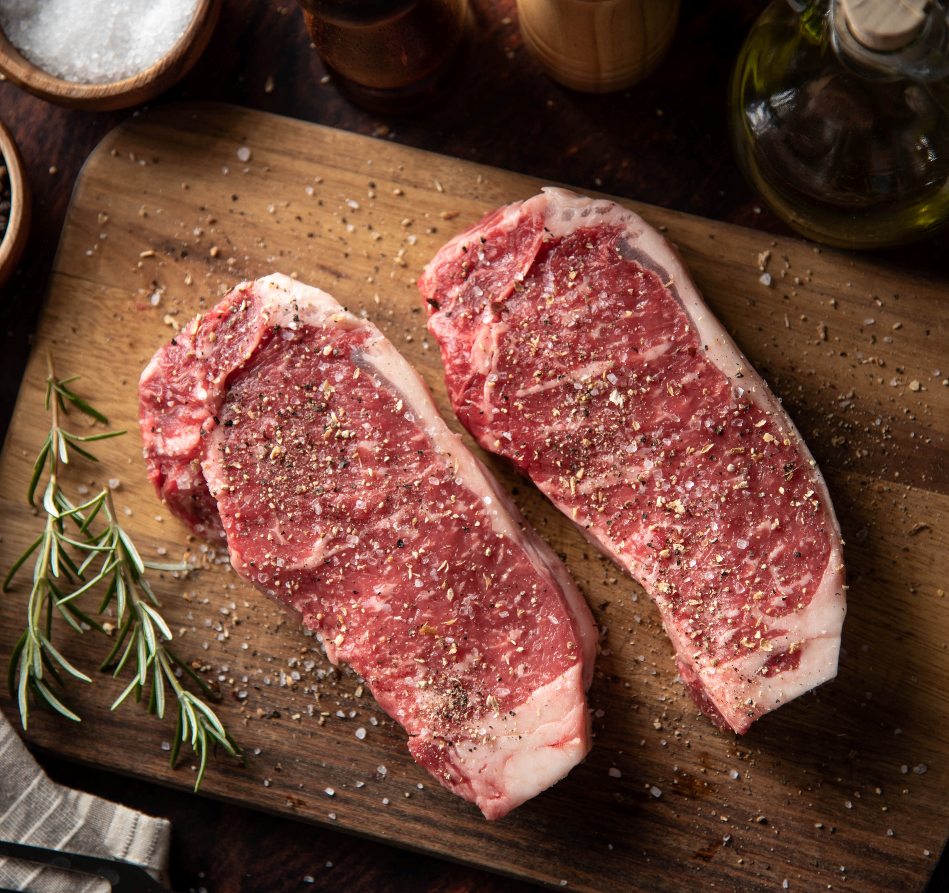
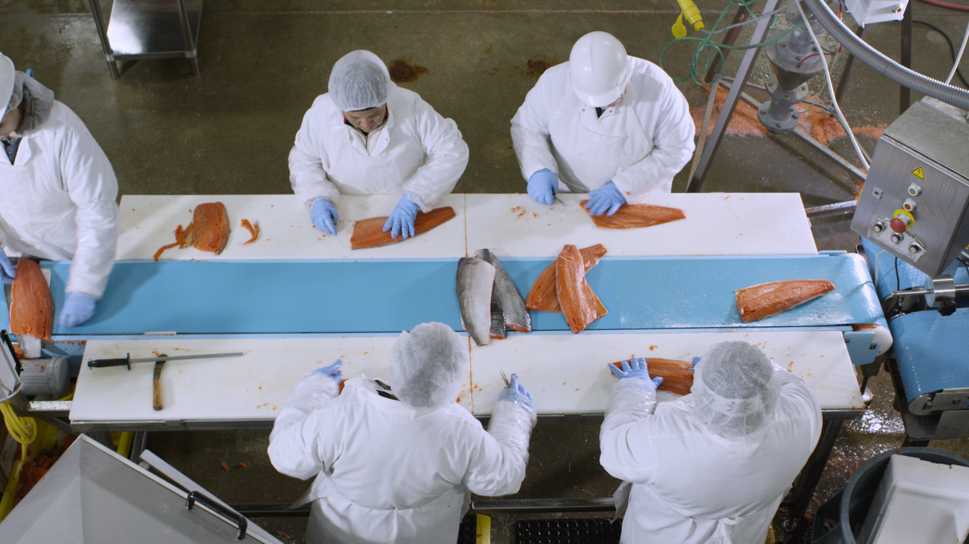
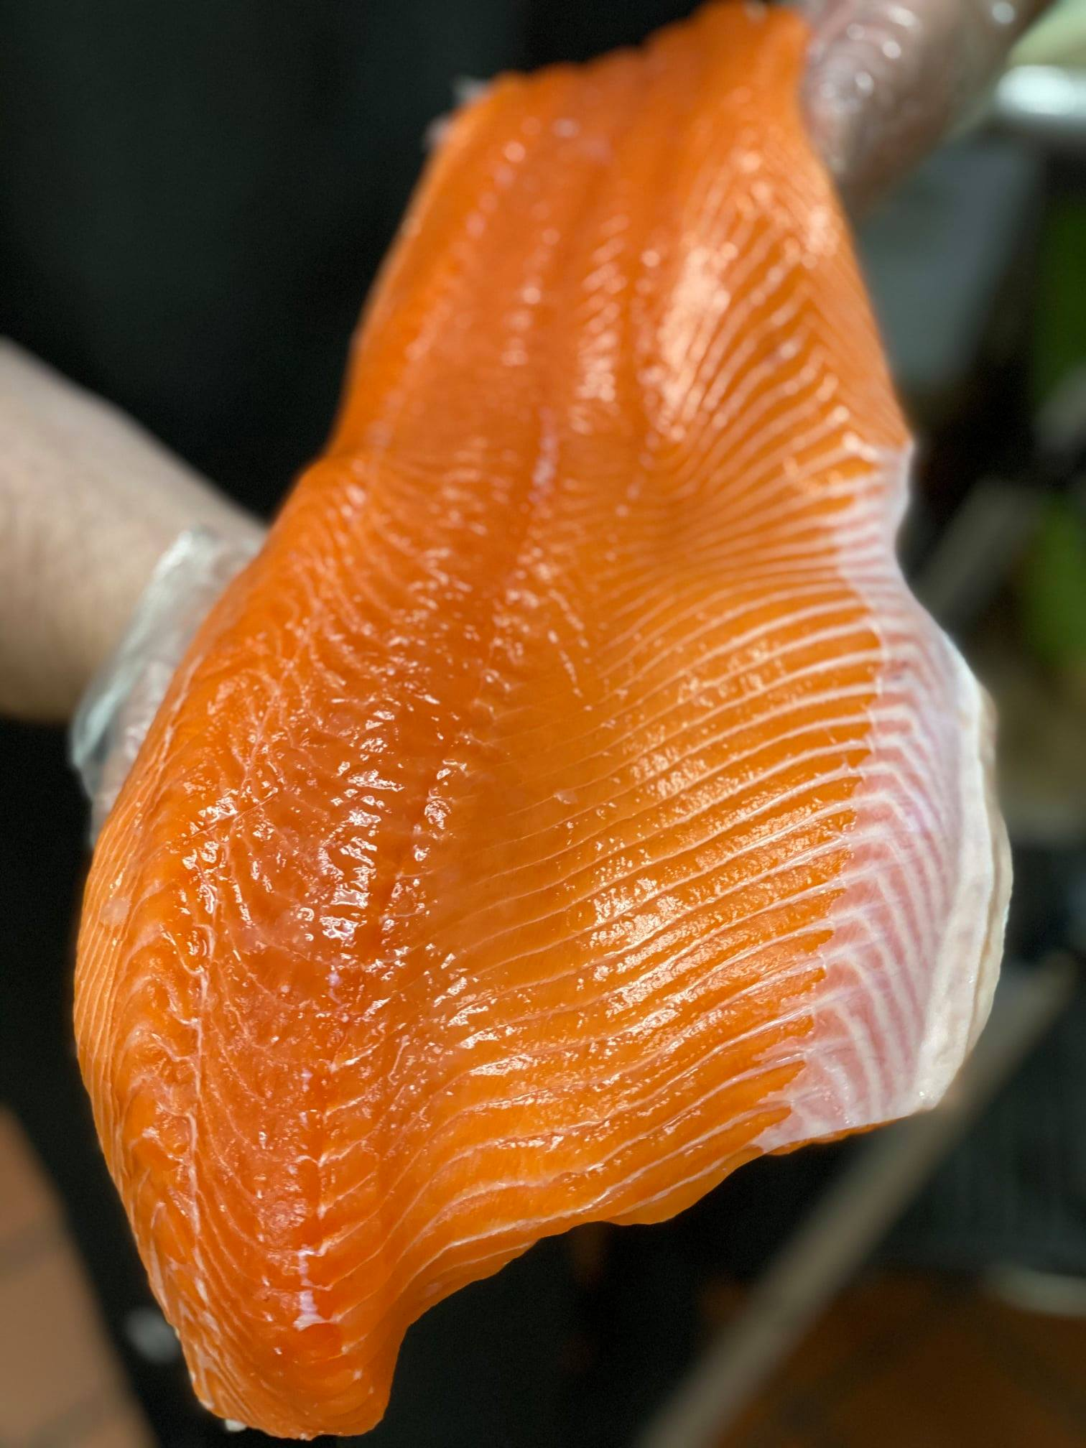
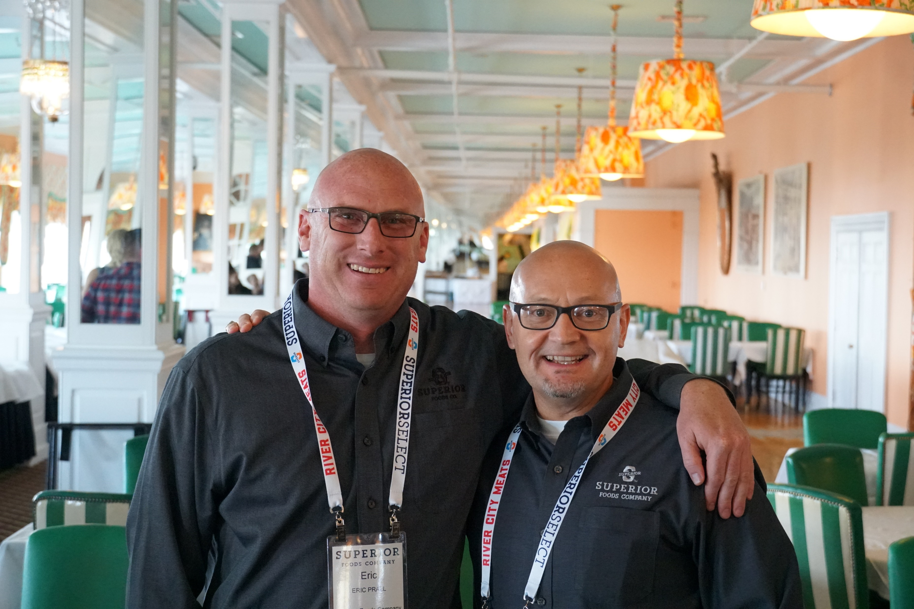
SUPERIOR SNAPSHOT
OUR FLEET
7,100
27 Trucks
(17 straight, 10 tractors, 12 trailers)
Distribution Center Delivery
Direct Store Delivery (DSD)
Available Products
2,200
STOCKED
ITEMS
2
65,000
sq. ft.
in our headquarter facility
SALES
DIVISIONS
&
26,000 sq. ft. in our
12
8
NEW Ready-To-Eat facility
FOODSERVICE
SALES REPS
RETAIL
SALES REPS
50,000 sq. ft.
3
of meat, seafood, and deli processing
ESTABLISHED
BRANDS
25,000 sq. ft.
River City Meats,
Black Pearl Seafoods
Superior Select Deli
of refrigerated/frozen
warehouse

Slide 4
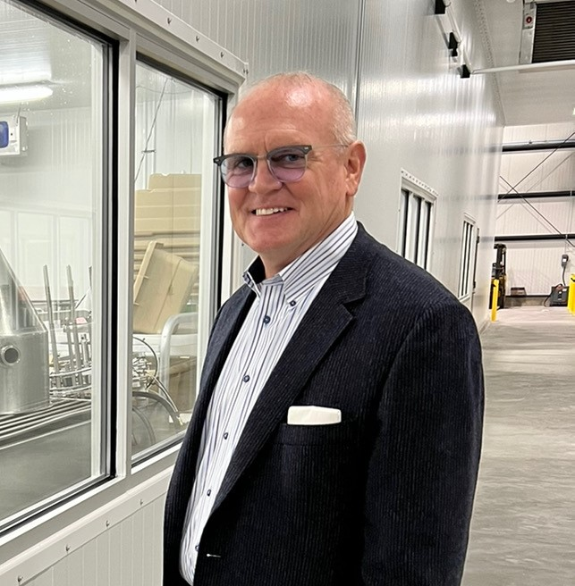
OUR MISSION
To provide quality products, resulting in an experience
that is nothing less than SUPERIOR!
“Our success is our customer’s success, if we can make
our customers successful, then we’ve done our job.”
- Jim Osterhaven, President/CEO

Slide 5
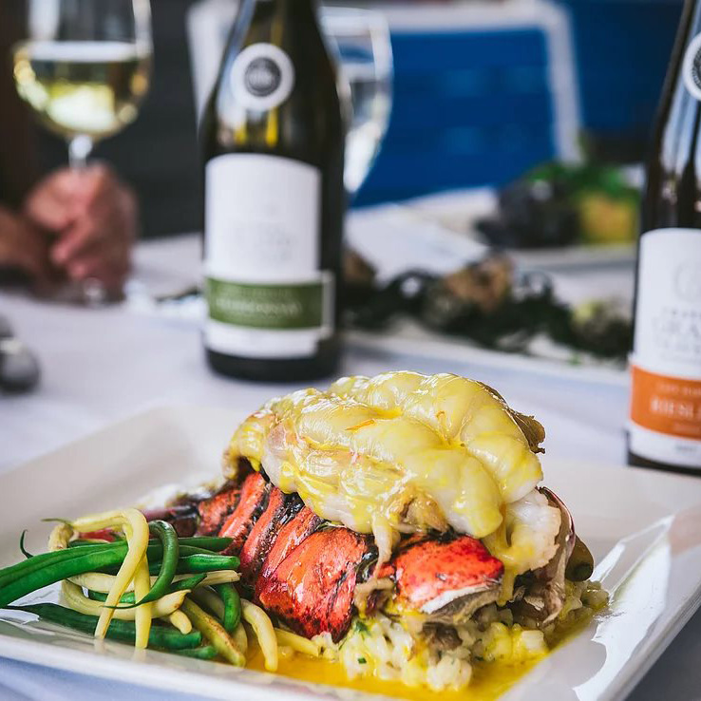
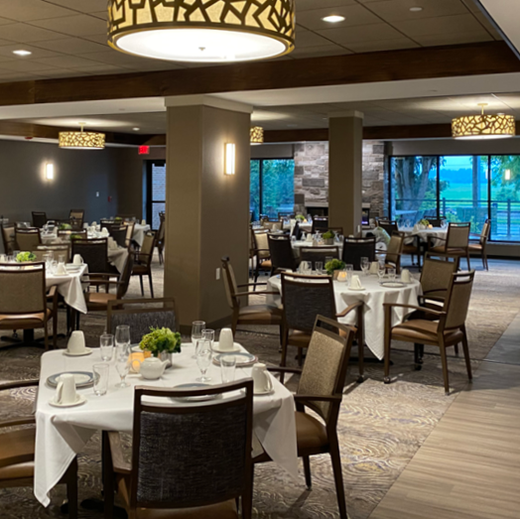
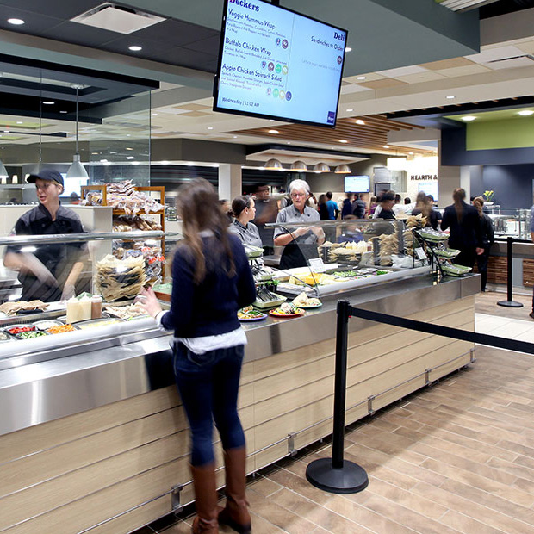
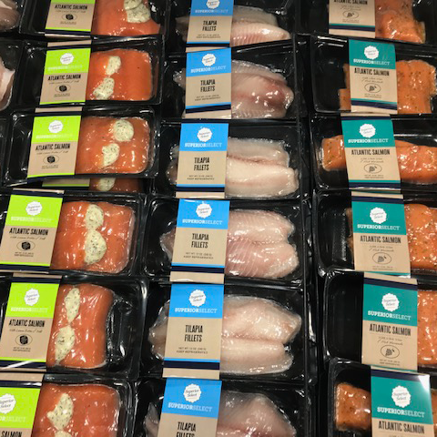
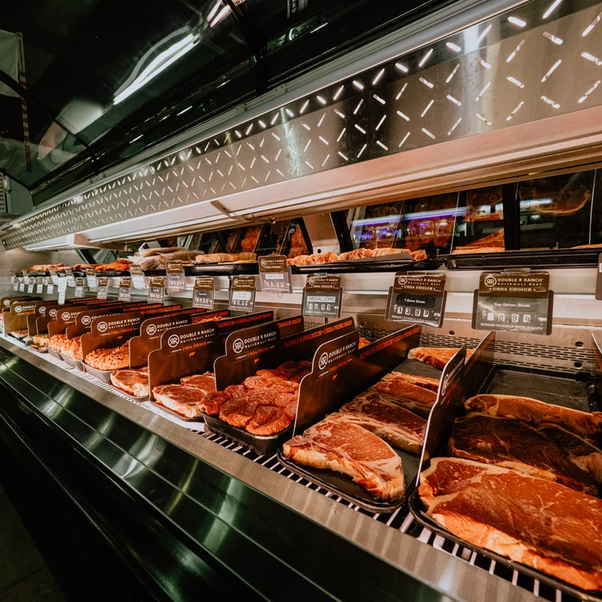
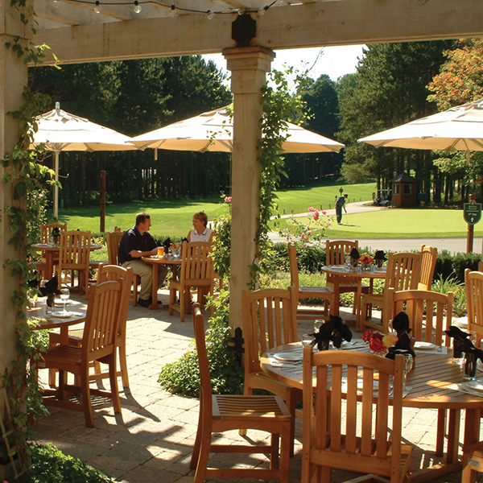
WHO WE ARE…
RESTAURANTS
HEALTHCARE
HIGHER EDUCATION
Protein & Specialty products company
Big enough to compete
Small enough to care
WHAT WE OFFER…
Quality
Service
Product Knowledge
WHERE WE SERVE…
Michigan, northern Indiana/Ohio with our route trucks
East towards New England, south towards Florida, west towards The Rockies
(serving retail warehouses)
RETAIL CHAINS SUPERMARKETS
SPECIALTY MARKETS
RESORTS & HOSPITALITY
WHY WE DO IT…
Committed to constant improvement
Invested in technology and equipment
Dedicated to developing products and strategies that bring our customers value

Slide 6
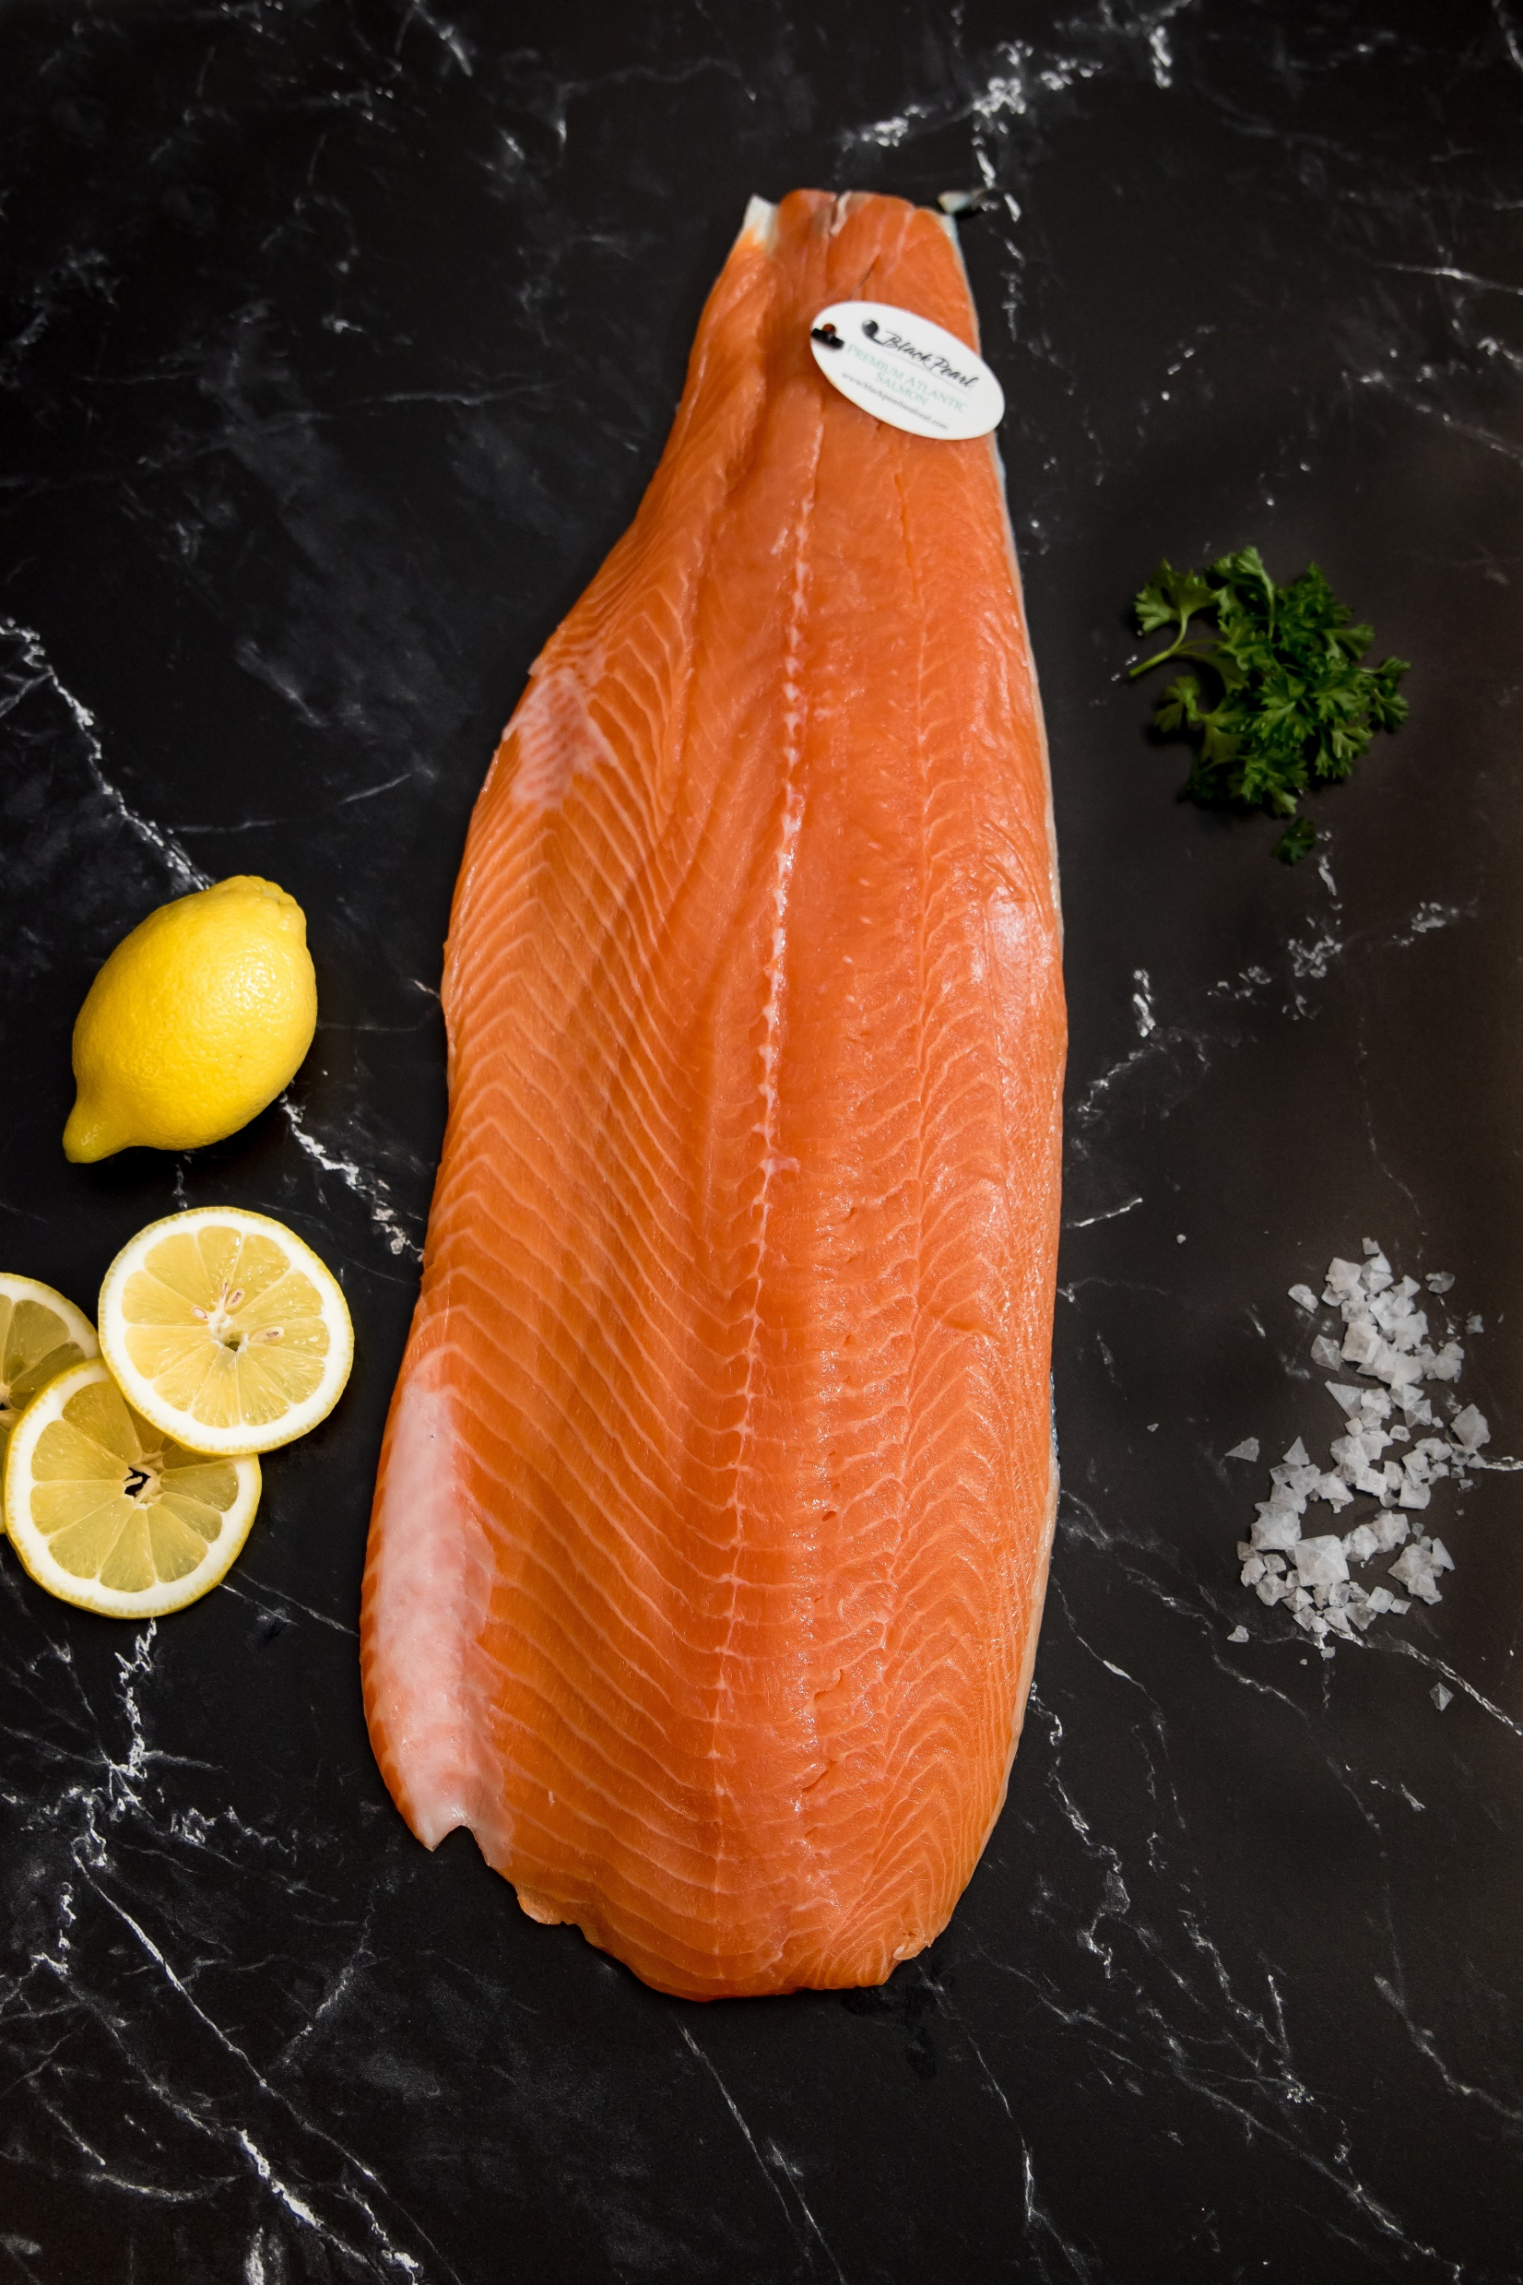

SEAFOOD
Into our 7th decade of seafood processing
Multiple semi-automatic processing lines
Custom packaging value-added products
Cut-To-Order fish and seafood
Highly skilled and highly valued processors/people
Advanced processing equipment including:
pin boning, portioning, skinning, and metal detection
Proprietary Signal Case™ packaging ensuring quality
and freshness
A longstanding premium seafood brand that was obtained in 2021. Our plan is to expand the
product line under the
banner.

Slide 7
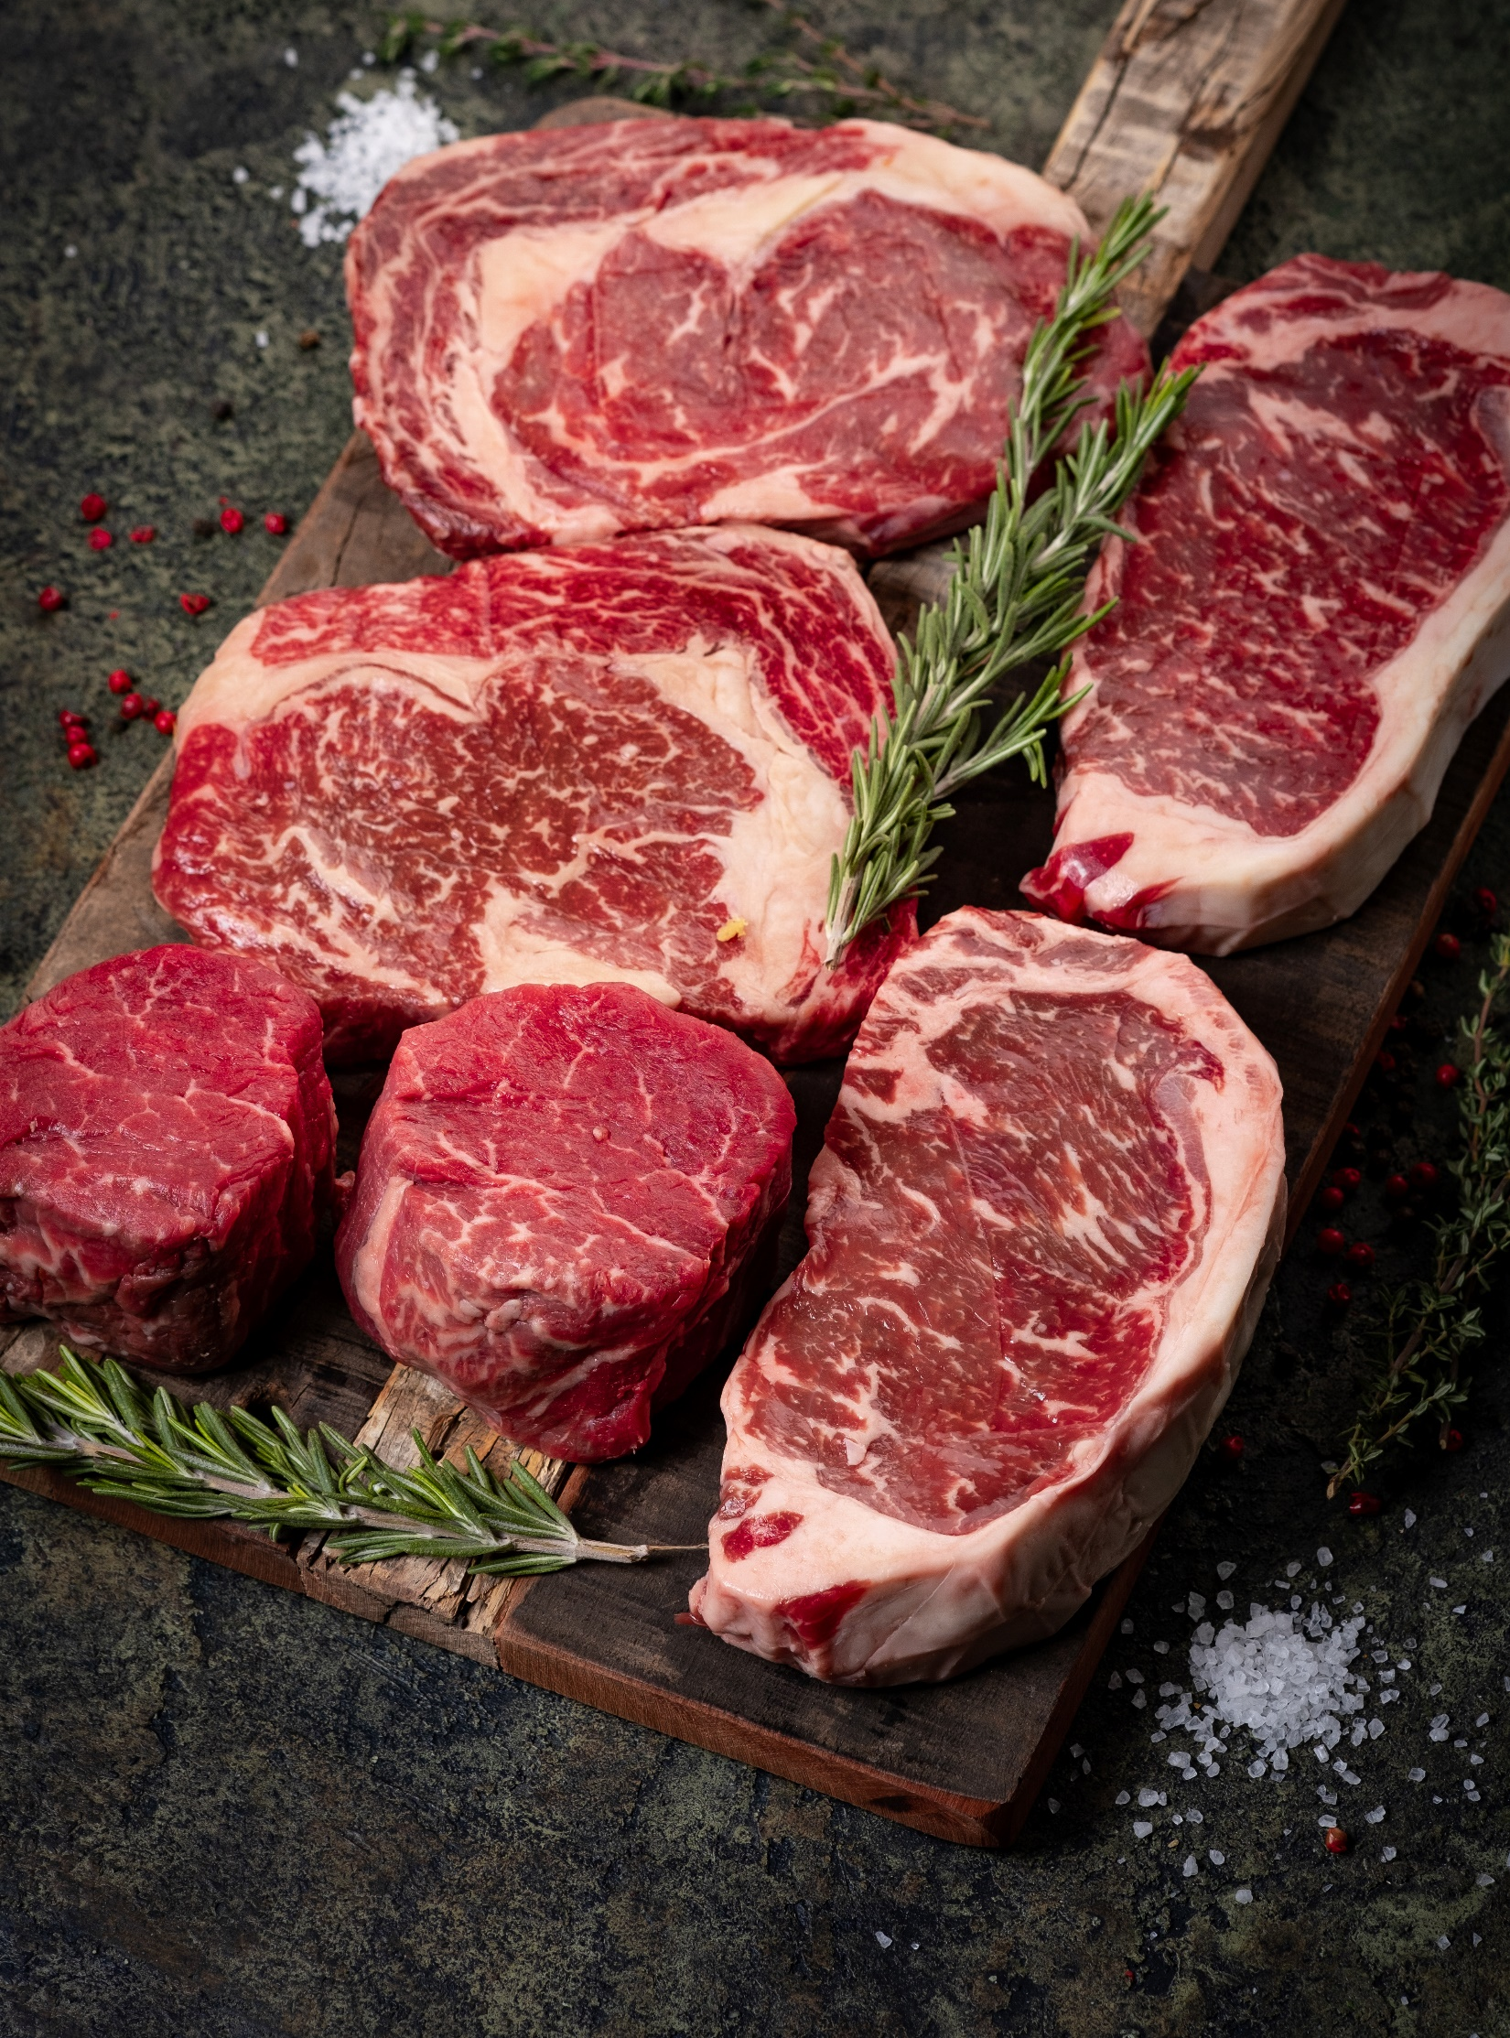
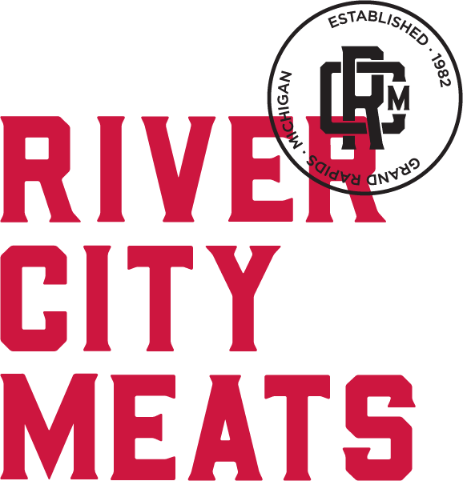
MEAT
Into our 4th decade of meat processing
Cut-To-Order beef, poultry, and pork program
Custom packaging, value-added product-lines
Partner with suppliers committed to sustainably and
humanely raised programs
NEW state-of-the-art FM 250 Reiser burger patty line
Enhanced processing including tenderizing, cubing, and
food grade band saws for ribs and chops
Versatile and innovative packaging and labeling
Highly skilled and highly valued processors/people
Perfected in restaurants and now redefining the retail market, River City Meats is the perfect combination of our value-added approach, customized packaging, and high-quality meat.

Slide 8
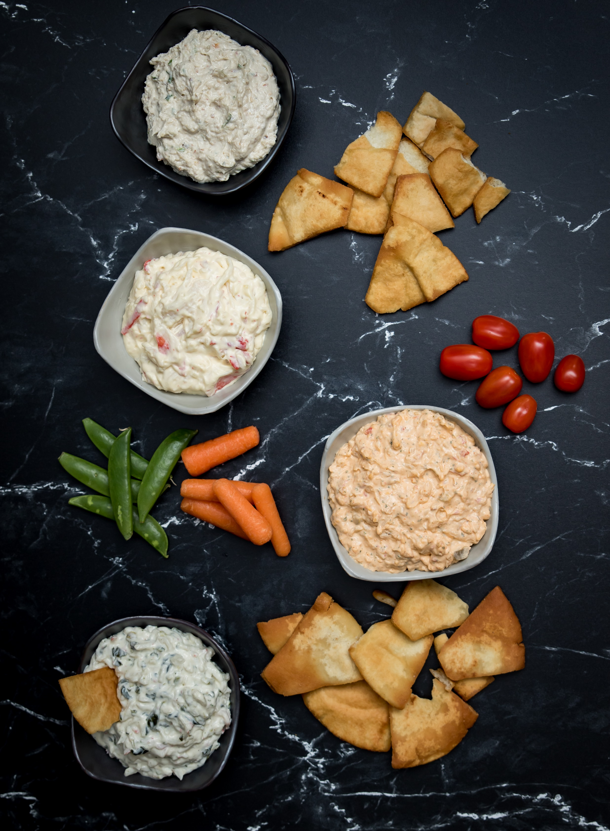
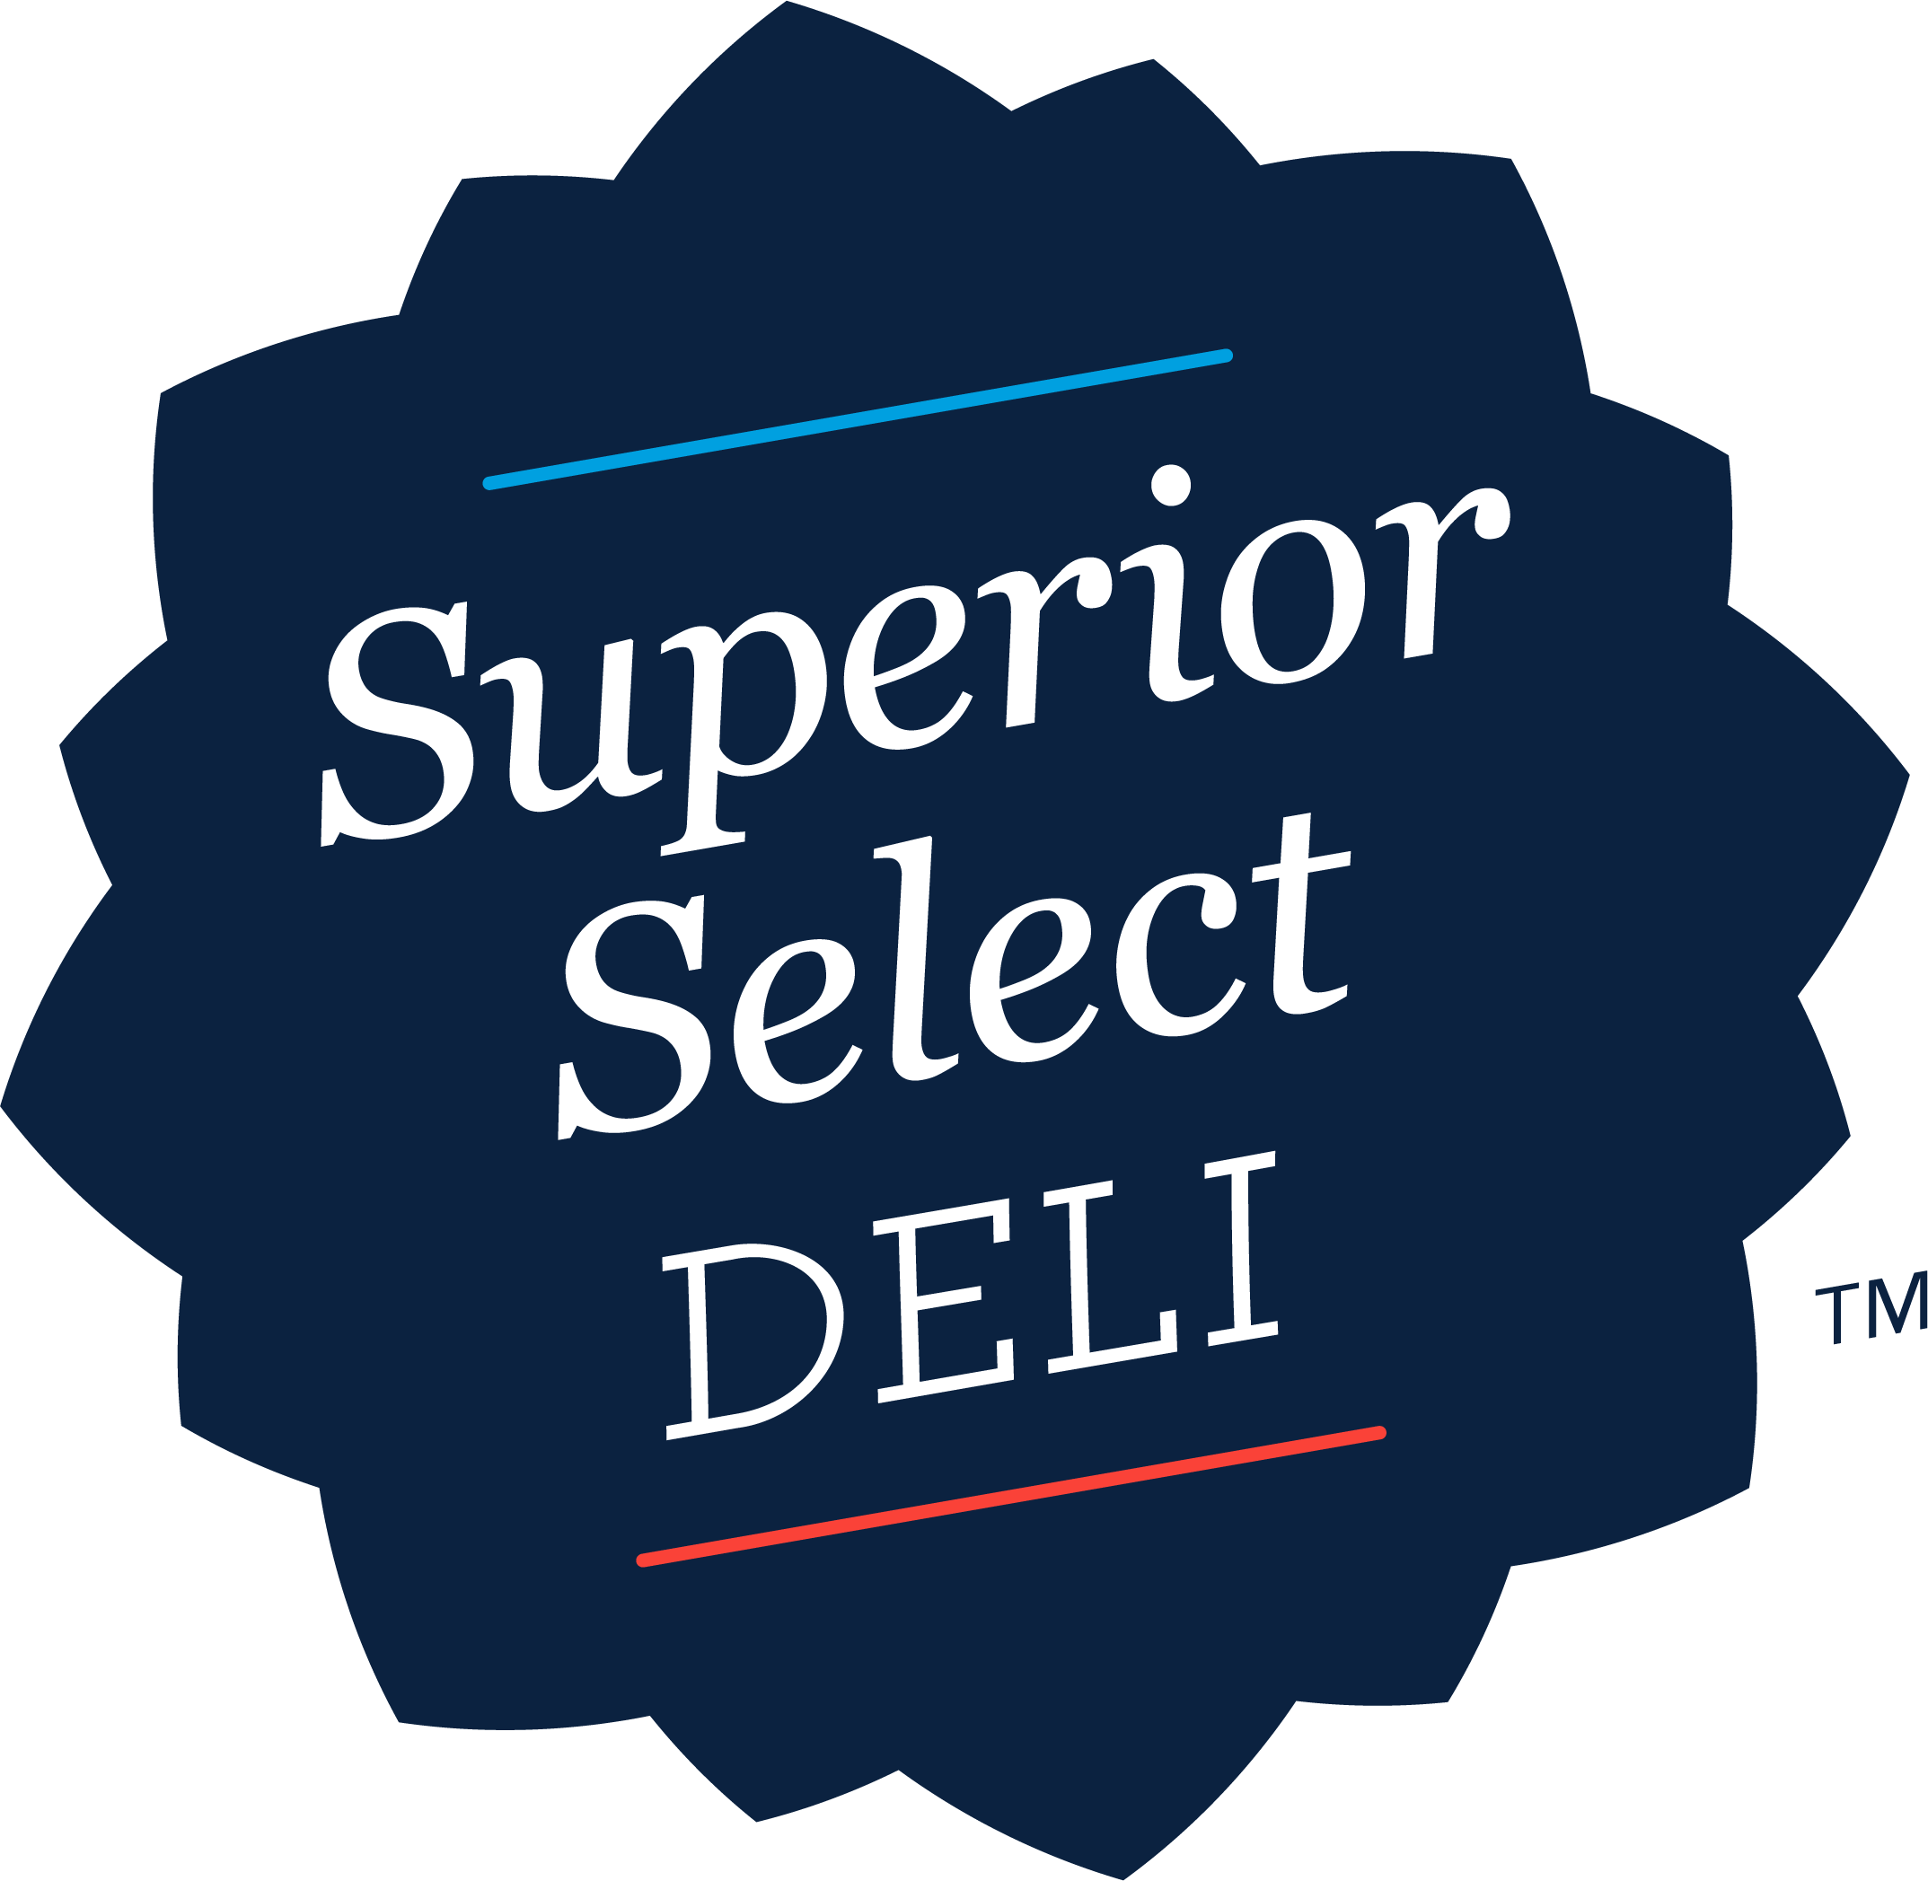
READY-T0-EAT
Starting our 3rd decade of retail packaged, as well as bulk
ready-to-eat foods
Specializing in Private Label and Co-Pack solutions
NEW 26,000 sq. ft. production facility
(USDA Certified, SQF Certified)
5 separate high performance, automated production lines
Versatile and innovative packaging and labeling
High Pressure Processing (HPP) capabilities
Advanced metal detection throughout
Superior Select Deli is a fast growing area of our business. We are continually developing new and innovative products that are both fresh and ready-to-eat.

Slide 9


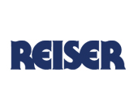




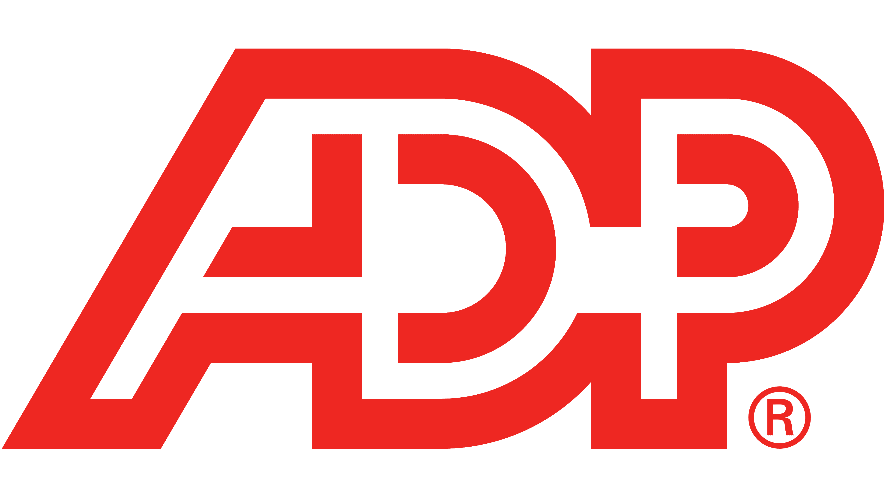

TECHNOLOGY
& AUTOMATION
Optimized ERP Platform
Cloud-based Human Resource System
Enhanced Sales Reporting Tool
Automatic Case Labeling Scales
High-speed gourmet burger former
Versatile Product Packaging
High-quality Packaging Machinery
Fleet Management System
All-in-one Visitor Check-in Solution
Flexible and customizable labeling Process

Slide 10
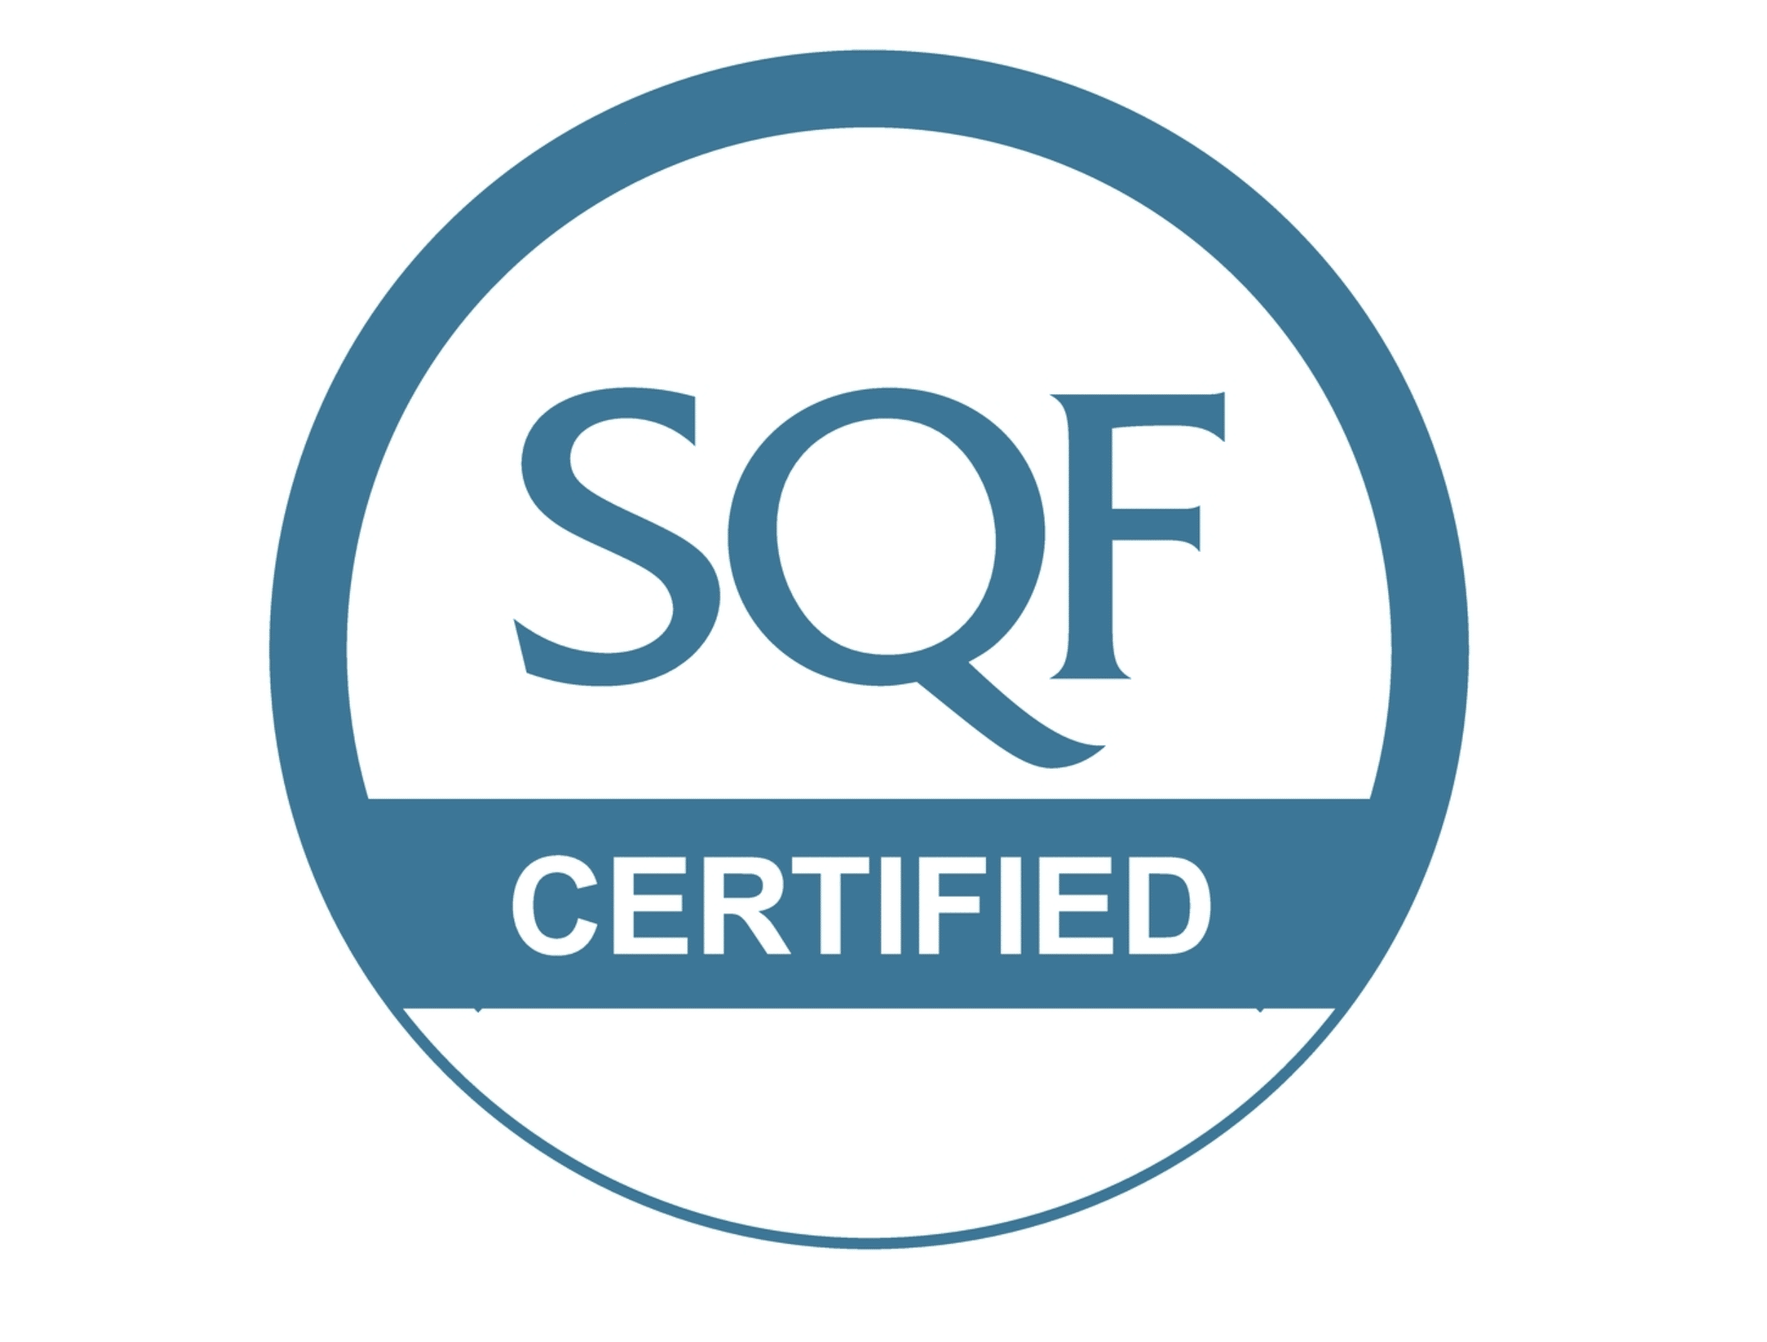

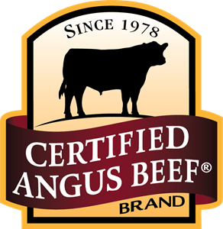




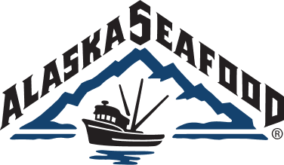
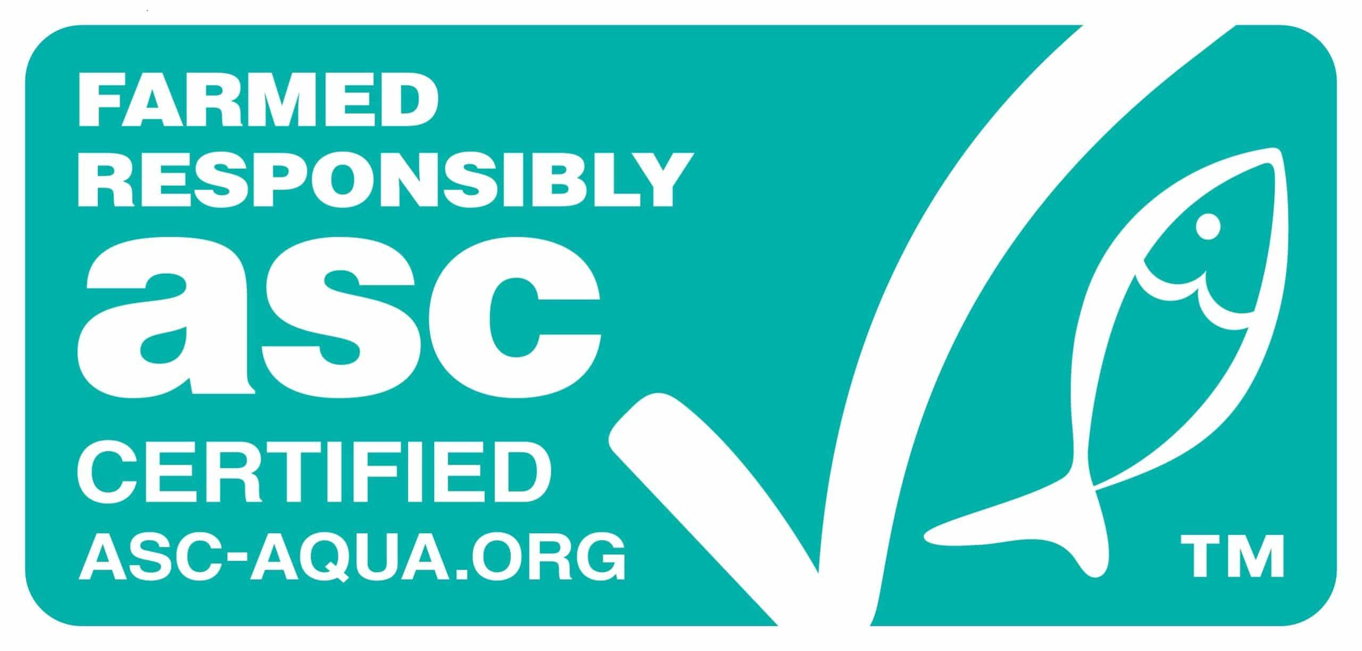
CERTIFICATIONS &
AFFILIATIONS
We are fully committed to the quality and safety of our products. Our production and warehouse facilities focus on ensuring that, not only do we comply with standards and guidelines, but that we go above and beyond wherever possible. Our facilities are USDA, FDA, and MDA inspected and have SQF certification. We also understand that it is not ‘all about us’ so we make sustainability and environmental consciousness a priority in everything that we do. We strive to work with like-minded suppliers who have certifications in and affiliations to sustainability and best practices.

Slide 11
